Slide 1
Topic: Algebra: Simplifying expressions EQ: How do I Multiply and Divide Terms?
Year 8 Mathematics
Mrs Parlevliet

Slide 2
Contents
Glossary or Formula Page
Page
Date
Description

Slide 3
Tasks
24
7
30
Essential Question
Questions
Notes
Summary
1
2

Slide 4
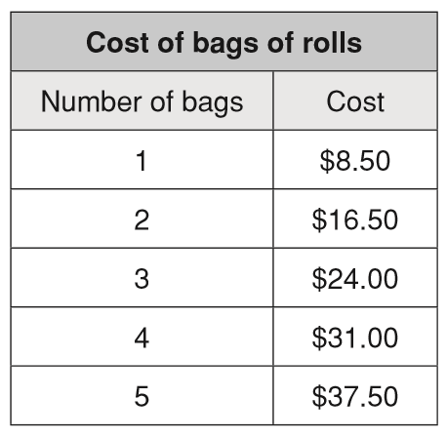
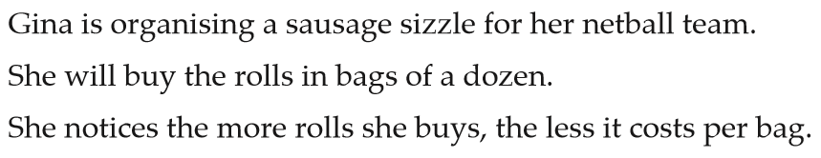

Five Questions (LHS)
Date: __/6/2019
Topic: Algebra
EQ – What do I multiply and divide terms?
Write the summary to yesterday’s lesson.
Simplify the following expression $3a+2b+3c+a−2c$
What are the terms in this equation $5x−2x^{2}+4xy=100$?
Define ‘quadrant’.

Slide 5

24
7
30
Algebra: Simplifying Expressions
WICOR
Date: __/6/2019
EQ – How do I Multiply and Divide Terms?
How do I multiply terms in algebra?
Simplify the following expressions
Example:
$4 ×3a =$
$3d ×4e=$
$6a ×3a=$
$5mn ×−2m$²$n$ =
Multiply the NUMBERS first
Group the variables (letters) second

Slide 6
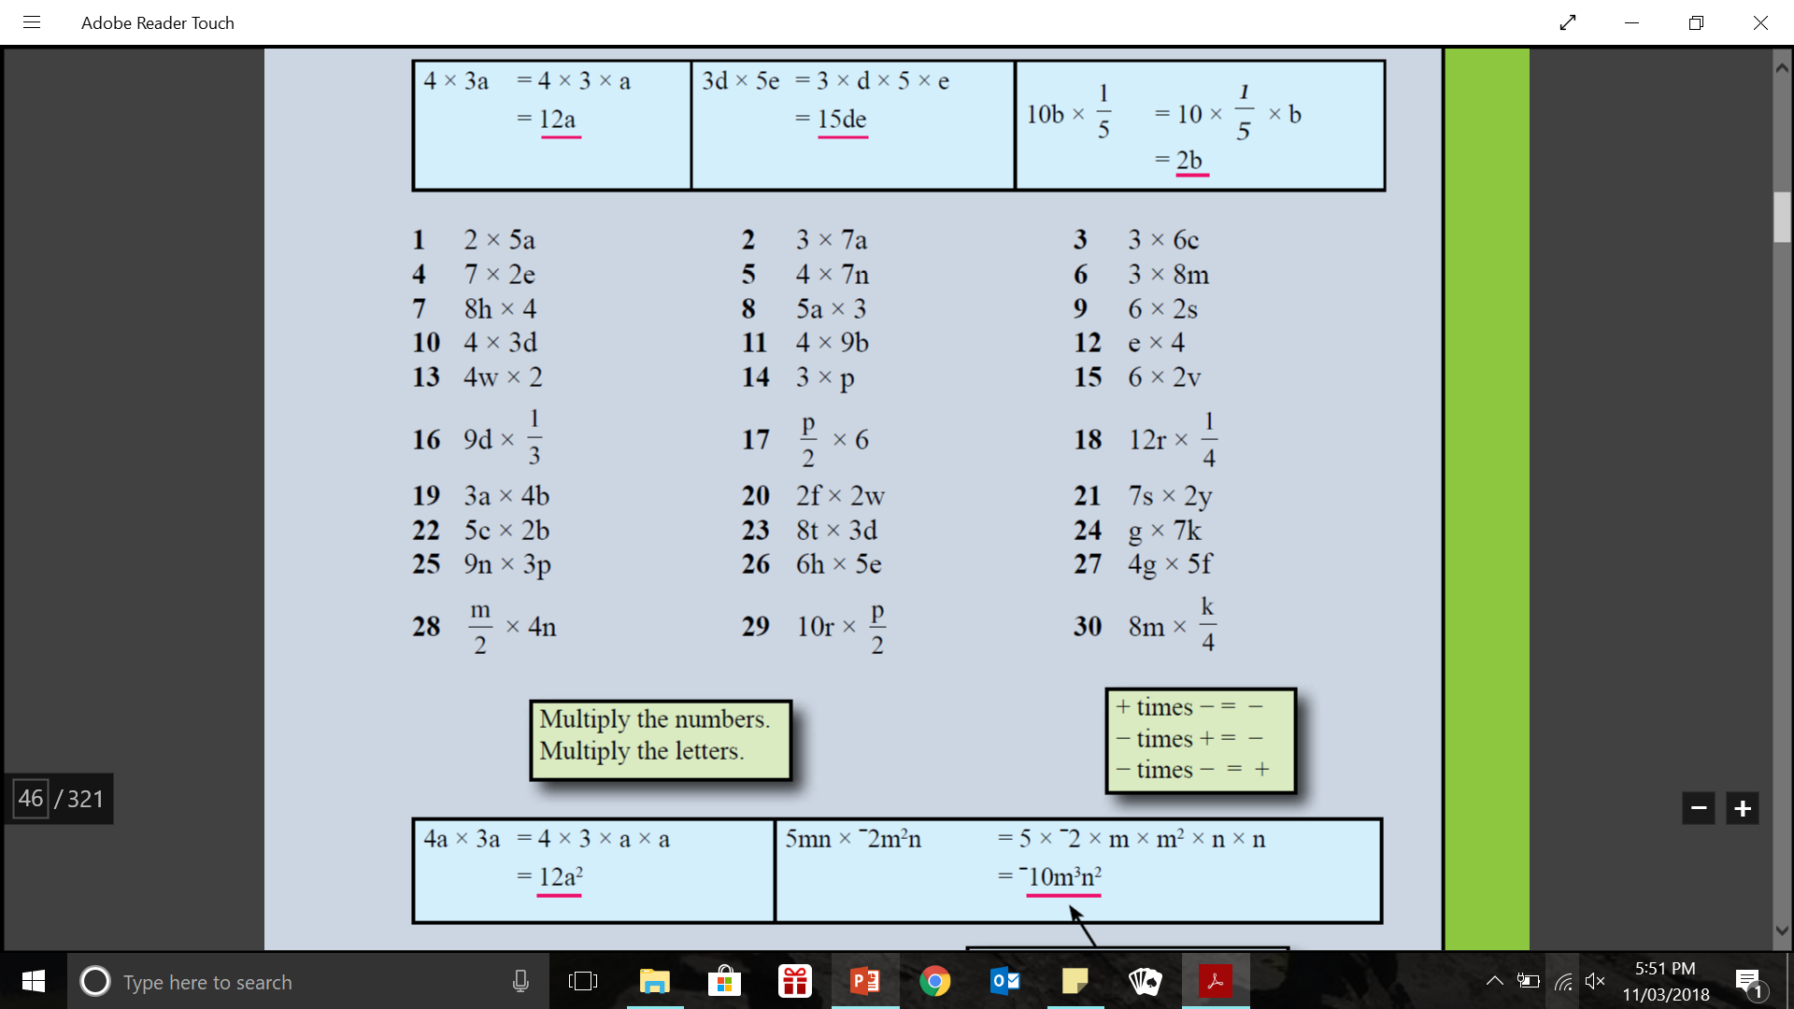
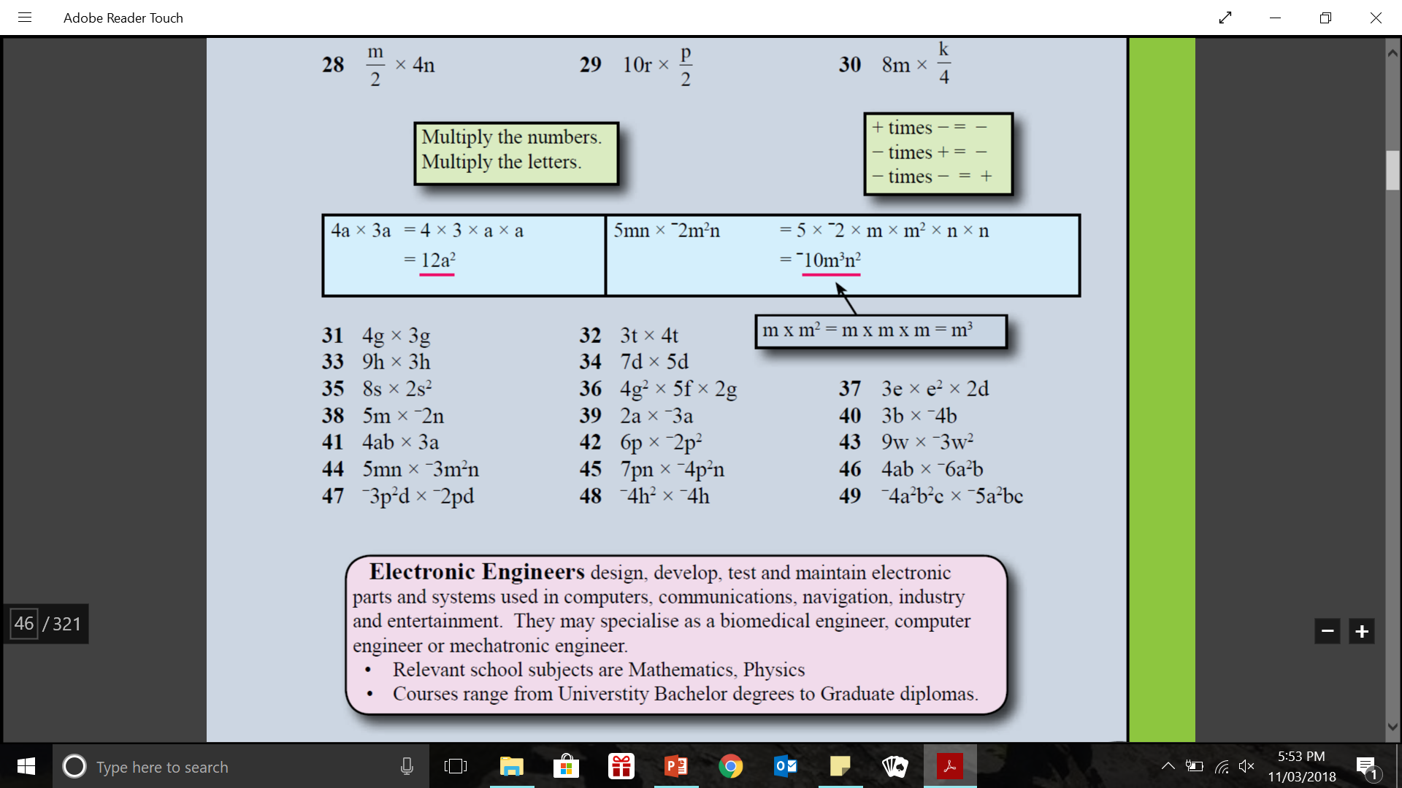
practice: - lhs

Slide 7


Slide 8
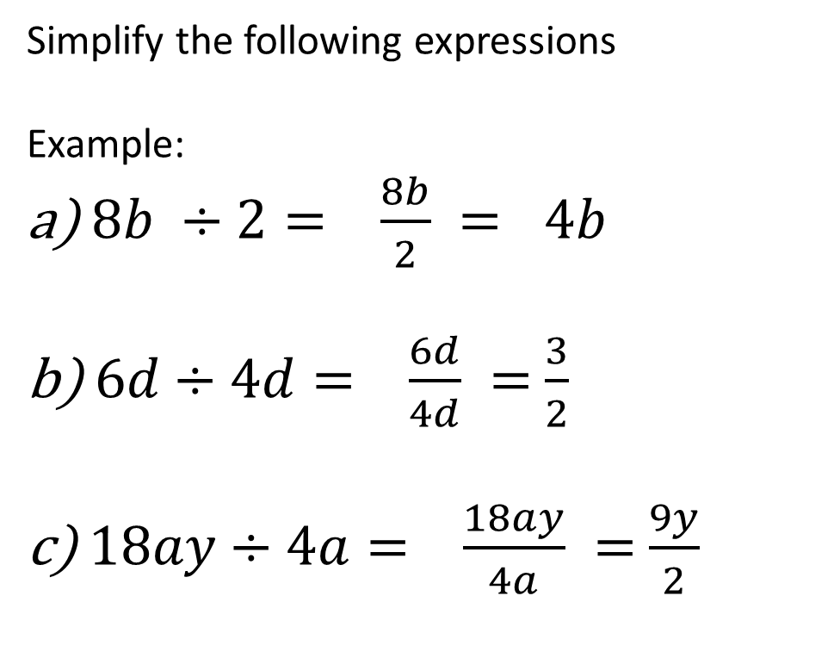
24
7
30
Algebra: Simplifying Expressions
WICOR
Date: __/6/2019
EQ – What are like terms and how do I collect them?
How do I divide terms in algebra?
Simplify the following expressions
Example:
$8b ÷2= \frac{8b}{2} = 4b$
$6d÷4d= \frac{6d}{4d} =$ $\frac{3}{2}$
$18ay÷4a= \frac{18ay}{4a} =$ $\frac{9y}{2}$

Slide 9
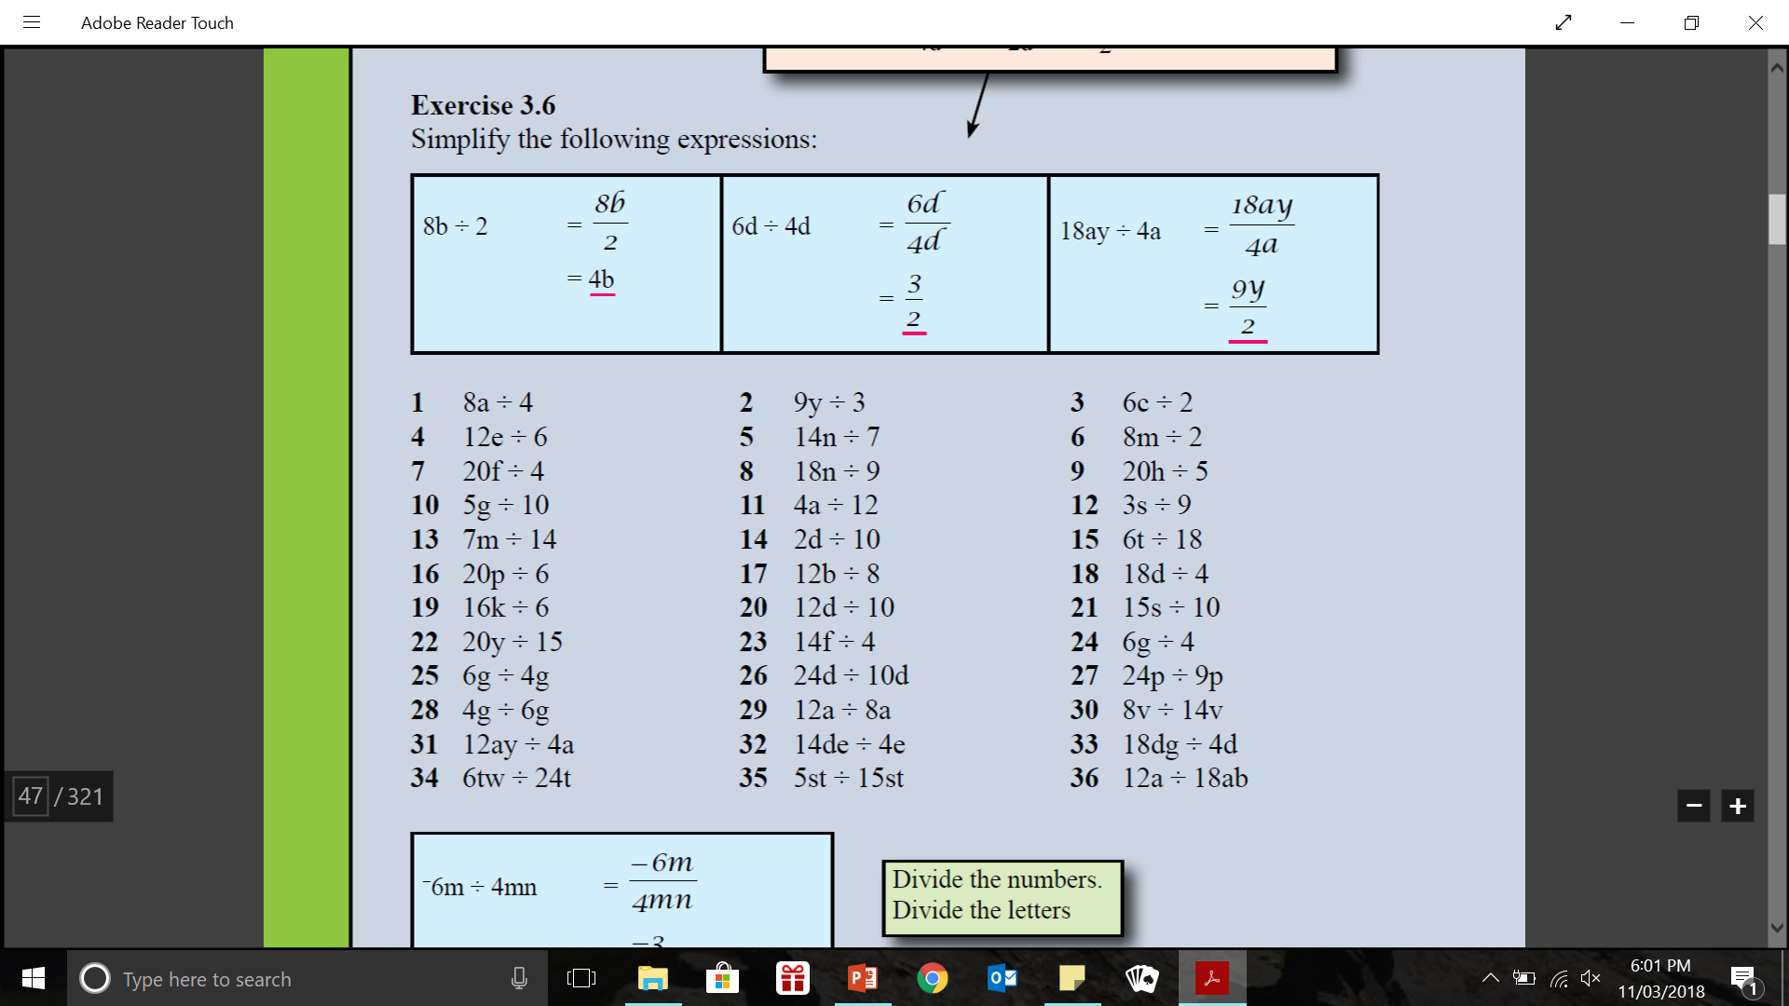
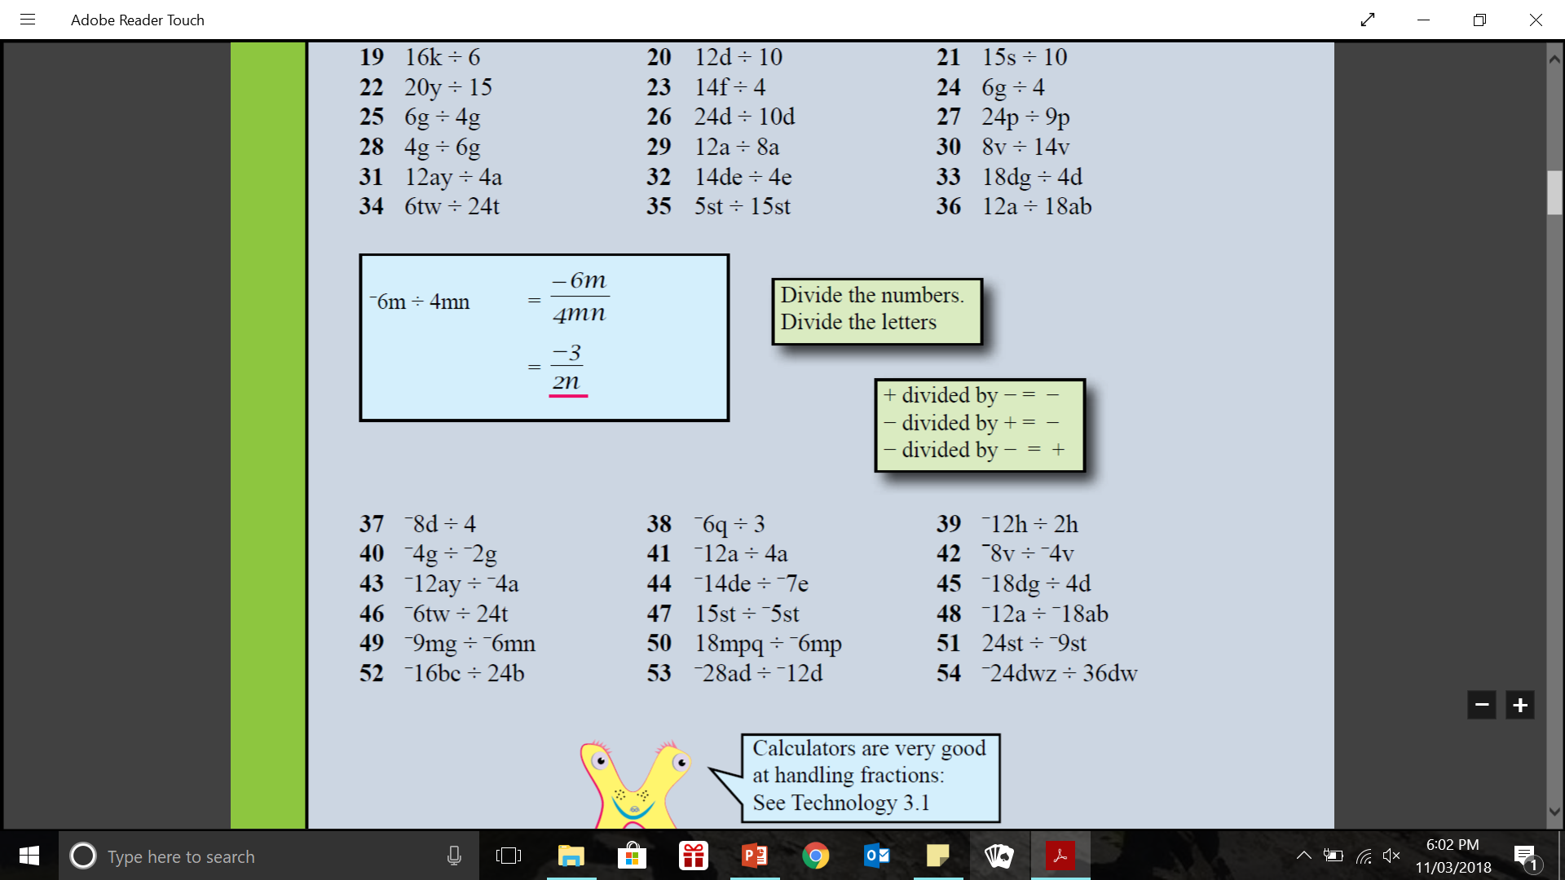
practice: - lhs

Slide 11
Task
Complete Exercises 3.5 and 3.6 on pages 37 and 38 of
Dwyer Year 8.

Slide 12

Write Your SUmmary
You have 3 minutes to write a summary that answers the Essential Question.
Be prepared to share your summary with the people sitting in your row.
This Photo by Unknown Author is licensed under CC BY-NC-ND

